Slide 1


Application of CSF4 in Avian Flu Grid:
Meta-scheduler CSF4.
Lab of Grid Computing and Network Security
Jilin University, Changchun, China
Hongliang Li (Simon)
2010-9-13
PRAGMA 19 workshop, Changchun, Jilin, China, Sep.13-15, 2010.
Notes:
Good morning everyone. My name is hongliang li, you may have received emails from me before addressed as Simon. That’s my English name given by my preliminary school English teacher. So, you can call me Simon if you want. I’m a PHD student of Professor Wei’s. Our laboratory is working on grid computing and network security.
Today, I will talk about the application of CSF4 in Avian Flu Grid, meta-scheduler CSF4, including some former and current achievements of CSF4.

Slide 2
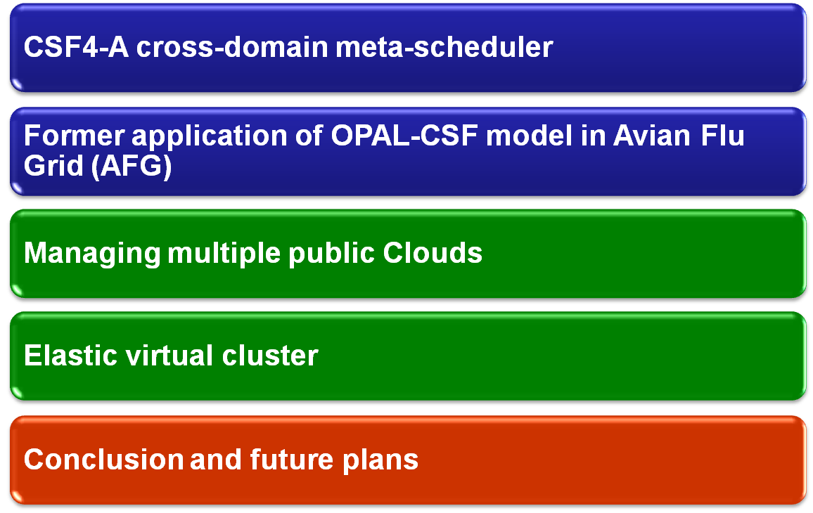
PRAGMA 19 workshop, Changchun, Jilin, China, Sep.13-15, 2010.
Notes:
Here’s the content of this talk. Today’s presentation consists of three parts.
Yesterday, today and tomorrow.
In the first part, I’ll give you an introduction about CSF4. Some of you may be very familiar with CSF4, since CSF4 have been deployed and practiced at SDSC for years, some of you may not. So I’ll give you a brief introduction so that you can catch up. There’s some introduction about the design of CSF4 and the OPAL-CSF model, which we finished last year. I’ll present some details in CSF4 part.
The second part is some new features of CSF4 that we finished recently. A new model of OPAL-CSF system. In this model, CSF4 manages multiple public cloud systems using OPAL. And a novel elastic virtual cluster model for parallel jobs.
In this part we will introduce the objective of these works, how we integrate these features into CSF4 and some design details
At last, there are some ongoing works.

Slide 3

PRAGMA 19 workshop, Changchun, Jilin, China, Sep.13-15, 2010.
Notes:
First, CSF4 introduction.

Slide 4
CSF4 introduction
Cross-domain meta-scheduler (grid-enable)
Grid protocol (portable)
  WS-GRAM, pre-WS-GRAM
  Organizing resources from different domain under control of diverse local schedulers
Scheduling plugin framework (extendable)
  Default plugin
  Arrayjob plugin
  Workflow plugin
  DataAware plugin
  OPAL service plugin
  Parallel job plugin
PRAGMA 19 workshop, Changchun, Jilin, China, Sep.13-15, 2010.
Notes:
CSF4 is known as one of the most functional grid-enabled meta-scheduler that can manage cross-domain resources.
Portability and extendibility are two major advantages of CSF4.
Portable
CSF4 is integrated with in globus container. Using standard grid protocols (both ws-gram and pre-ws-gram) csf4 can manage computing resources from different kind of local schedulers (fork, sge, pbs, lsf, etc.).
Extendable
One of the most important features is the scheduling framework of CSF4. CSF is first released in 2004. During these years, the scheduling framework is proved to be efficient and extendable. We have extended resource mangers in CSF to accommodate to new grid protocols or other resource sites. We have developed more scheduling policies. These policies are implemented into CSF by scheduling plugins. The scheduling framework makes CSf extendable.
As you can see in this slide, we’ve already developed several scheduling plugins
Default, arrayjob, workflow, dataaware. I’ll show you the idea of each plugin latter.
The last two, that colored green is our recent work. That we integrate these two work into csf with new scheduling plugins. They are described in latter sections.

Slide 5
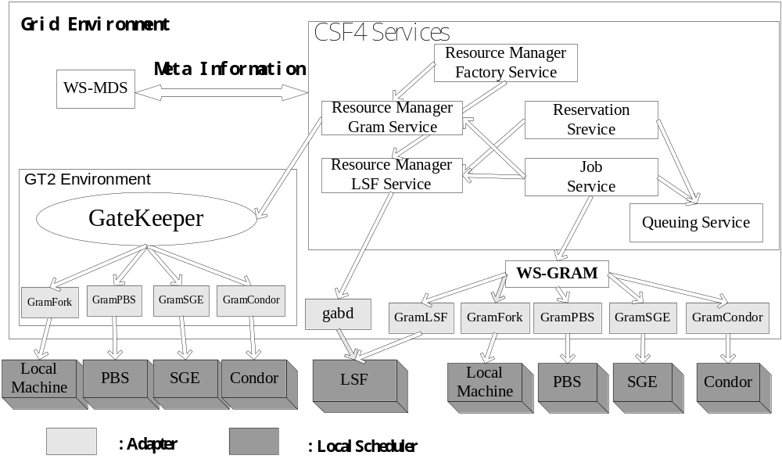
CSF4 modules
Job Service, Queue Service, Resource Managers
Supporting diverse local schedulers by grid protocols
PRAGMA 19 workshop, Changchun, Jilin, China, Sep.13-15, 2010.
Notes:
This slide shows the module design of csf. As we can see in this picture, there are several service models within CSF. The most important are jobs service, queue service and resource manager.
Job service deal with the life cycle of jobs, job submission, job scheduling, and job dispatch.
Queue service is in charge of queueing jobs, managing scheduling plugins.
Resource managers deal with job submission and monitoring job status with different local managers. Different resource manager using different communication protocols.
As we can see, CSF4 use both gram and ws-gram grid protocol to support different local schedulers.

Slide 6
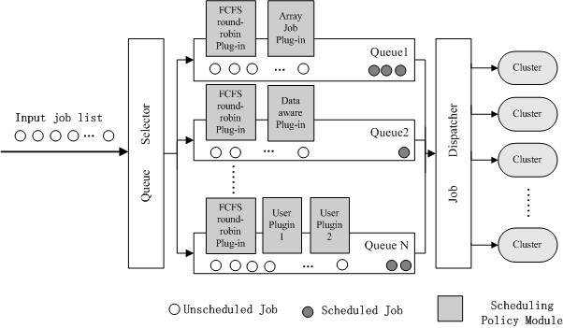
Scheduling framework
Support multiple scheduling plugins co-operate together
PRAGMA 19 workshop, Changchun, Jilin, China, Sep.13-15, 2010.
Notes:
This slide indicates the scheduling plugin framework of csf4. We support multiple queques. Each queue is configured with several scheduling plugins. Each queue has a default plugin using fcfs scheduling policy.
Queue 2 uses two plugins dataaware plugin and fcfs plugin.
Also, users can develop their own plugins implementing their specified policies.
Different plugins can work cooperately in this framework. Plugins works as the order of the arrow. For example, the fcfs plugin works firstly, make dispatch dicisions and them dataaware plugin functions its own strategy.
Let’s see some examples of plugins in csf4.

Slide 7
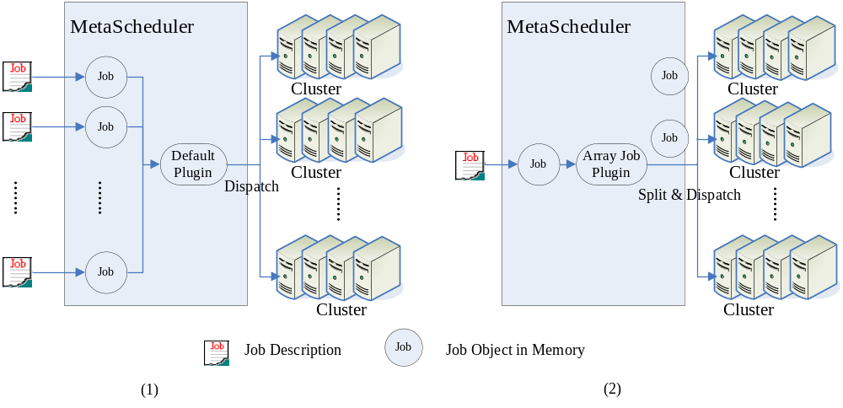


Default and Arrayjob plugins
Arrayjob consists of multiple subjobs(SIMD)
PRAGMA 19 workshop, Changchun, Jilin, China, Sep.13-15, 2010.
Notes:
Firstly, the arrayjob plugin.
Array job is a typical SIMD job that consists of a set of subjobs that share the same binary files and computing different inputfiles.
Array job plugin is in charge of split one arrayjob into subjobs and schedule these subjobs to clusters.

Slide 8
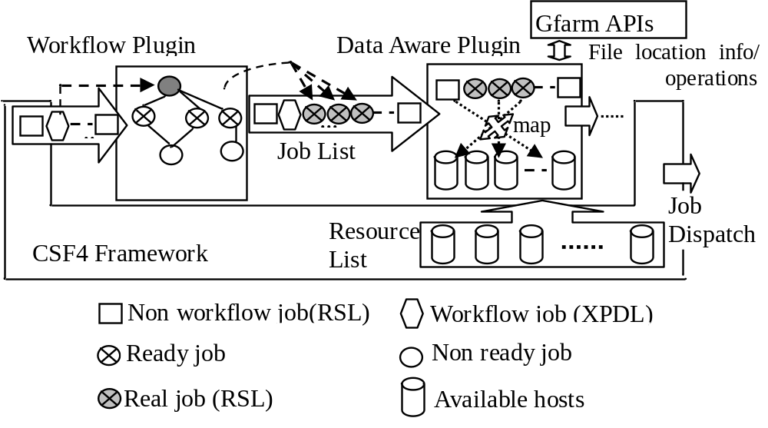
Two plugins working together
Workflow jobs are spitted to subjobs by Workflow plugin
DataAware plugin allocate resources for these subjobs
PRAGMA 19 workshop, Changchun, Jilin, China, Sep.13-15, 2010.
Notes:
This slide shows the cooperation of two plugins.
The example job is a workflow job that some of the subjobs are dependent to certain files.
The workflow is described as a xml file. Workflow plugin will first split the job into subjos according to this xml file and dispatch jobs according to there dependent relationships.
Each job will then go through dataaware plugin to search for there dependent files.

Slide 9

PRAGMA 19 workshop, Changchun, Jilin, China, Sep.13-15, 2010.
Notes:
In this part, we will introduce the former design of opal-csf model.

Slide 10
Integration of CSF4 and OPAL
OPAL-CSF4 biomedical cloud
  Enable large scientific applications (Virtual screening, Autodoc, 2000 Arrayjobs)
  OPAL deals with service management and user interfaces
  CSF4 deals with cross-domain job scheduling
PRAGMA 19 workshop, Changchun, Jilin, China, Sep.13-15, 2010.
Notes:
This model is designed to serve large-scale biomedical applications like Autodoc.
According to requirement of SDSC, each virtual screening application carries of several autodoc process, which consists 2000 scale arrayjob. Clearly, there are huge among of jobs in this system.
As we known, OPAL is a very useful tool to mange applications as web services, and provide useable GUI for consumers.
Another very valuable feature of OPAL is that, it support a extendable architecture that uses different job mangers to manage different executing environments.
So a CSF job manager is implemented in OPAL to take advantage of cross-domain clusters.

Slide 11
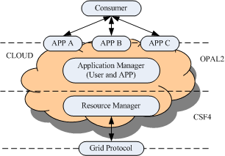
OPAL-CSF4 cloud model
CSF4 as a job manager of OPAL
PRAGMA 19 workshop, Changchun, Jilin, China, Sep.13-15, 2010.
Notes:
In this model, front-end consumers submit service requests to OPAL using web GUIs.
These jobs are then forwarded to CSF. CSF managed multiple cross-domain clusters that are in charge of job execution.

Slide 12
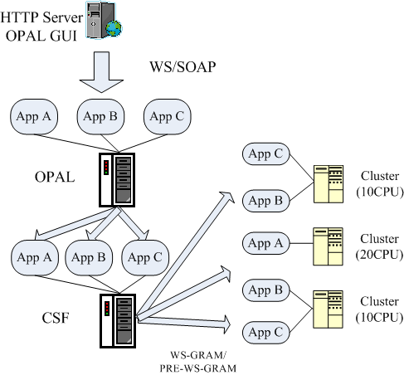
System structure
Application management
Cross-domain scheduling
Input/Output file transfer
PRAGMA 19 workshop, Changchun, Jilin, China, Sep.13-15, 2010.
Notes:
OPAL is in charge of application management, while csf deal with cross-domain scheduling and file transfer.

Slide 13
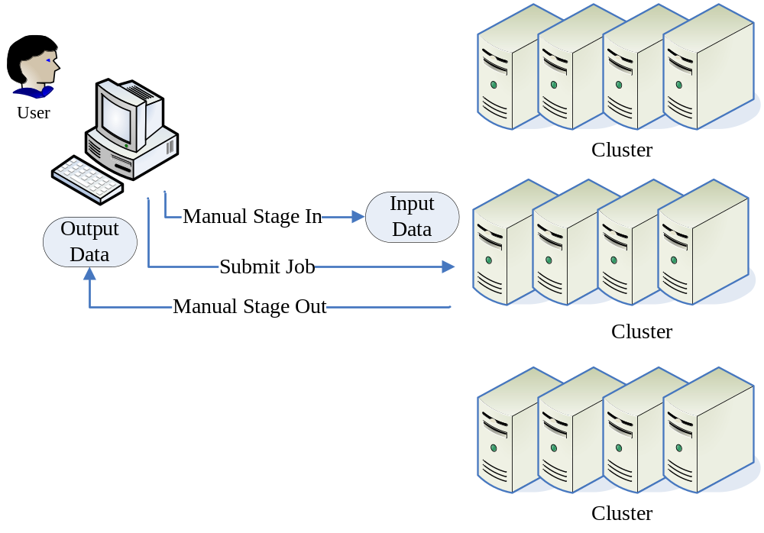
CSF4 stagein&stageout
PRAGMA 19 workshop, Changchun, Jilin, China, Sep.13-15, 2010.
Notes:
As discussed, there are great amount of subjobs in this application. In autodoc application, each subjob depends on several dependent files that organized as folders.
Before actually executing, these files must be arranged on executing host. After execution, output files must be transferred to opal as well. Manually transsion is almost impossible.
This is doen by another important feature of CSF, which is file stagein/stageout feature.

Slide 14
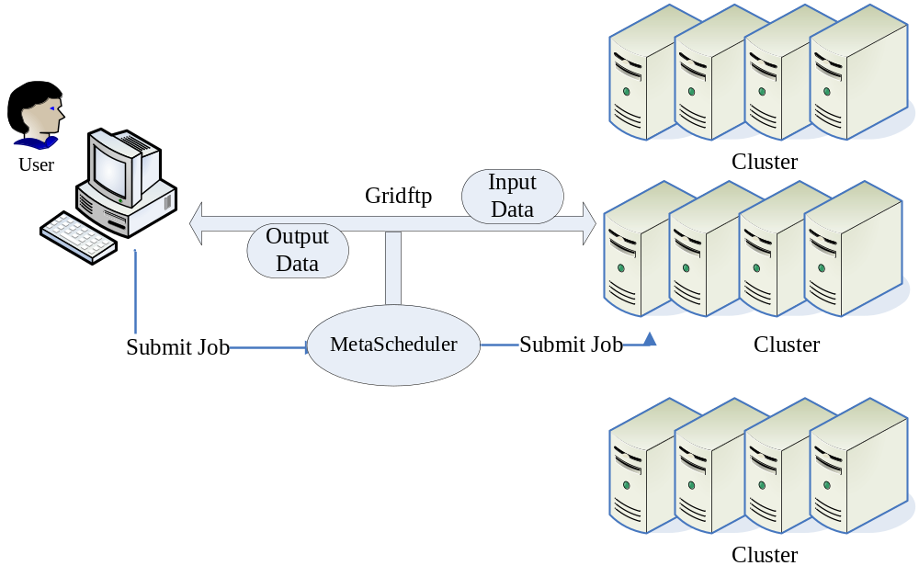
CSF4 stagein&stageout
PRAGMA 19 workshop, Changchun, Jilin, China, Sep.13-15, 2010.
Notes:
Each subjob of autodoc application have a folder to store its input files. Subjobs of the same autodoc instance share some common files as well.
As a result, current version of CSF support recursively stagein and stageout dependent files according to user requirements.
This feature greatly improves the usability of the system.

Slide 15
Improvements of CSF4
  Cross-domain dynamic file transfer
    Recursively transmit files and folders for each job (subjob)
  Job re-submission
  Max walltime
    Default values in configuration file
    User defined with RSL files
  2000 array jobs stable
    PRAGMA Grid testbed
    Latest CSF4 release(Version 4.0.5.1 and 4.0.6).
PRAGMA 19 workshop, Changchun, Jilin, China, Sep.13-15, 2010.
Notes:
It is worth mentioning that the last version released last year has been through 2000 scale array jobs tests in pragma grid, and is proved to be stable.

Slide 16

PRAGMA 19 workshop, Changchun, Jilin, China, Sep.13-15, 2010.
Notes:
The previous slides shows some former works about CSF, which recall you of the design of our meta-scheduler.
From this section, we will discuss some new features of CSF.
The paradigm of grid computing helps to share resources among different administration domains and make the executing of large-scale scientific applications like autodoc possible.
Unfortunately, one of the most short coming in grids is the usability of HPC systems.
Clouds are designed to solve this problem. Applications in clouds are organized as web service to end users. And the resource management details are hided in clouds to improve the usability.
However, the computing power of one cloud is limited after all. Sometimes, you have to find out a way to share service capacity of different public clouds to run large-scale applications.
That’s the background of the new opal-csf model.

Slide 17
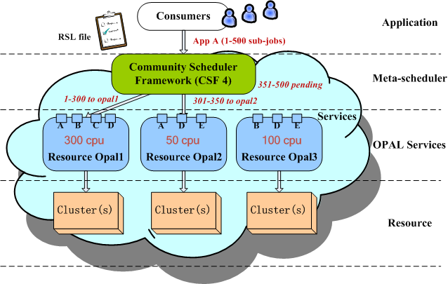
New OPAL-CSF4 Cloud model
OPAL as resource manager of CSF4
CSF4 allocate service instances of OPAL for jobs
PRAGMA 19 workshop, Changchun, Jilin, China, Sep.13-15, 2010.
Notes:
As we can see, in this slide. We lift CSF beyond opal in this model to share service capacity of different OPAL sites.
CSF works as a broker between consumers and opal sites in this model.
Consumers submit service requirements to CSF using rsl files. CSF manage a list of all services provided by opal sites. And map these requirements to different opal sites.
As we can see, this job request uses service A. Then CSf will dispatch these jobs to opal sites that provide such service.

Slide 18
New OPAL-CSF4 Cloud model
OPAL as virtual resource manager in CSF4
  Job submission, job monitoring
CSF4 managing multiple OPAL sites
  Site status (CPU, service) updates (modifying in OPAL)
CSF4 allocate service resource of multiple sites
  New interface of Job submission (URL to entire directory, URL to list file of directories) (modifying in OPAL)
Scheduling OPAL service jobs and maintaining lifecycle of jobs
  New scheduling plugin (OPAL Service plugin)
  Monitoring job status using status files
PRAGMA 19 workshop, Changchun, Jilin, China, Sep.13-15, 2010.
Notes:
Now, let’s see how this work is done.
OPAL works as virtual resource manager in CSF4. We’ve implemented a new resource manager named resource manager opal, which in charge of job submission and job monitoring.
Back to this slide. As a scheduler, CSF4 managing multiple opal sites, control the status of sites, such as available CPUs.
Current OPAL package does not open such functions, so that we modified some of the codes in opal. Since CSF4 is just a broker of OPAL sites. Some other consumers can still using opal resources. The CPU amount of OPAL sites can be dynamically changed. CSF4 will keep updating these information in a relatively long interval.
To understand this part, we have to go through the job submission mechanism of OPAL.
OPAL have a GUI that helps consumers to submit jobs. Consumers are requested to give a URL that liked to a folder to dependent files of applications. Each Autodoc application contains multiple subjobs, which give us multiple folders. OPAL count the number of folders to know the amount of the arrayjobs.
CSF may dispatch one arrayjob to different opal sites. In order to follow this mechanism, CSF must transferred input files on to localhost and split the input file folder into different folders according to subjob dispatch decisions. And then use new urls to submit jobs to OPAL. This is quite time consuming. So, we modified some of OPAL jobs to support new interface of job submission that users can submit a url to a list file that contained the urls of all dependent directories. OPAL will use this list to do file transfer.
In this way, CSF works as a complete broker that do not concern file transfer, but only concern job scheduling.
In order to manage this new type of job (OPAL jobs), we designed a new scheduling plugin in CSF that is in charge of life cycle management.

Slide 19
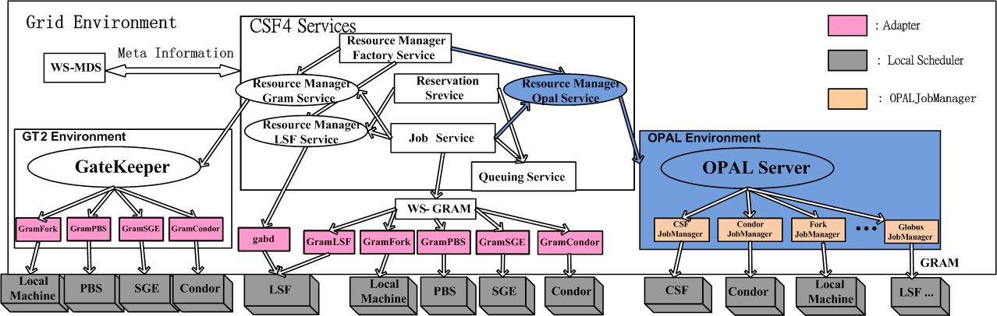
New Resource manager
Extend a new resource manager:
  “Resource Manger Opal Service”
PRAGMA 19 workshop, Changchun, Jilin, China, Sep.13-15, 2010.
Notes:
As illustrated in this slide, the blue part are the new resource manager, which are extended from original CSF resource manager interface.

Slide 20
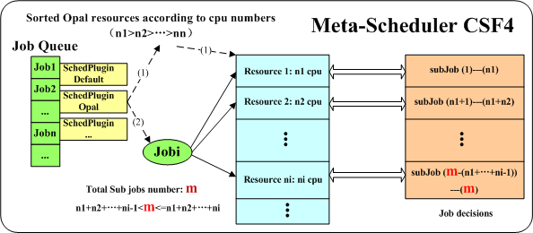
Scheduling plugin
A: Select Opal sites according to service requirement;
B: Sort opal resources according to CPU numbers;
C: Spread arrayjobs to different sites
PRAGMA 19 workshop, Changchun, Jilin, China, Sep.13-15, 2010.
Notes:
This slide shows how one autodoc application is scheduled in CSF to OPAL sites.
First, CSF will select opal sites according to service requirement. Candidate opal sites that provide this service are listed.
Then these opal sites are sorted by cpu amount from large to small.
At last, a arrayjob is splited according to OPAL sites’ computing capacity and forwarded to opal site.

Slide 21
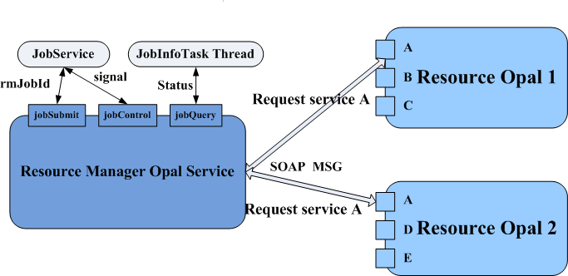
Communication mechanism
Using SOAP protocol to cooperate with OPAL (URLs)
Monitoring job status using status files
PRAGMA 19 workshop, Changchun, Jilin, China, Sep.13-15, 2010.
Notes:
This slide shows how CSF and OPAL communciates with each other. We use some standard opal interfaces to request service. These requests are packaged as soap messages.
The status monitoring is relatively harder that, opal do not have interfaces for that. We check the status file that provided by opal to get the status of jobs.

Slide 22
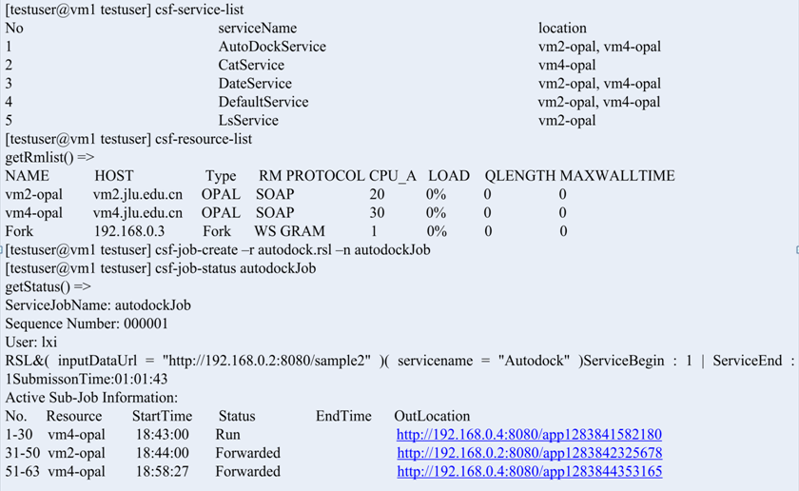
Configuration and Experiments
<cluster>
<name> vm2-opal </name>
<type> OPAL </type>
<host> vm2.jlu.edu.cn </host>
<port> 8080 </port>
<version>2.4</version>
<home>/home</home>
</cluster>
<cluster>
<name> vm4-opal </name>
<type> OPAL </type>
<host> vm4.jlu.edu.cn </host>
<port> 8080 </port>
<version>2.4</version>
<home>/home</home>
</cluster>
PRAGMA 19 workshop, Changchun, Jilin, China, Sep.13-15, 2010.
Notes:
This

Slide 23

PRAGMA 19 workshop, Changchun, Jilin, China, Sep.13-15, 2010.
Notes:
This part we will discuss the latest designed feature of CSF4. Elastic virtual cluster.

Slide 24
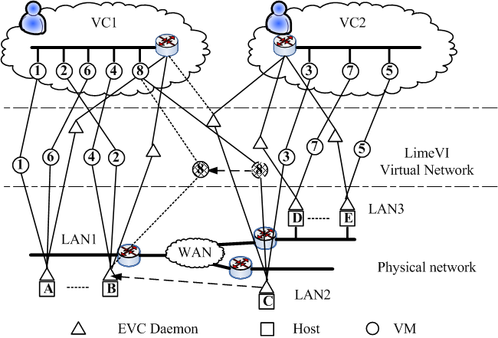
EVC model
Customized, isolated and secure executing environment for parallel applications.
Resource manager
Virtual Infrastructure
VMM
PRAGMA 19 workshop, Changchun, Jilin, China, Sep.13-15, 2010.
Notes:
The revival of virtualization technology provide novel perspective to build usable hpc systems.
Elastic virtual clusters are designed based on virtualization technologies to provide customized, isolated and secure executing environment for parallel applications.
EVC is supported by a well designed virtual infrastructure that support reconfiguration of virtual clusters in runtime. One can expanse or shrink the scale of virtual cluster in runtime. The most important feature of EVC is that it support virtual machine live migration. The communication topology among VMs in the same Virtual cluster can be reconstructed dynamically by a well-designed migration protocol.
As a result, EVC supports parallel applications.

Slide 25
Support EVC in CSF4
Objectives
  Parallel job co-allocation
  dynamic executing environment deployment (VJM)
Extend VJM module to manage EVC (EVC manager)
  Resource reservation using Vjobs, Vjobs manage virtual machines, EVC manages virtual clusters
  Creating, reconstructing and rearranging virtual clusters
New scheduling plugins: parallel job plugin
  Parse VC requirements of jobs; prepare VCs dynamically in runtime; distribute parallel jobs to VC
Others
  Integrate VJM as a separate service in CSF4
  VC status monitoring using VJM
  Real job monitoring
PRAGMA 19 workshop, Changchun, Jilin, China, Sep.13-15, 2010.
Notes:
The objective of supporting EVC in CSF is to enable parallel job co-allocation and dynamic executing environment deployment.
This is based on our previous work virtual job model (VJM). Before actually dispatching parallel job. CSF sends out virtual jobs to reserve resources for parallel job. When all the resources are ready, parallel job can start up together to save wall time.
We extend VJM to manage EVC in CSF4.
First, CSF dispatches virtual jobs to clusters. Each vjobs starts a virtual machine. VJm manages all Vjobs to constitute a virtual cluster for consumers.
the creating, reconstructing and rearranging of virtual cluters are managed by EVC manager.
In order to achieve such goal, we designed a new scheudling plugin parallel job plugin to parse Vc requirements of parallel jobs, prepare virtual clusters dynamically, and distribute real parallel jobs to virtual cluster. Some other issues are also addressed in CSF. Such as…
Note that, this work is different from other dynamic virtual clusters that, EVC is on a per-job basis, that each virtual cluster only serve one parallel job. This greatly improved the security of executing environment. EVC is designed for large-scale parallel job that have large executing wall time.

Slide 26
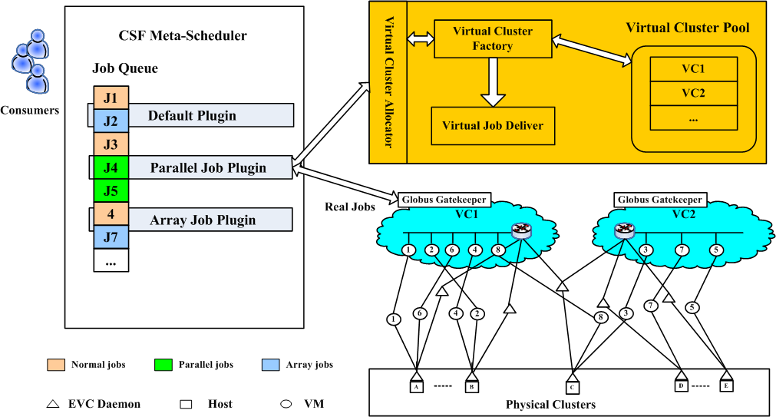
Parallel job scheduling in CSF4
Two phase resource allocation in parallel job plugin
  Construct virtual clusters according to job requirements
  Distribute real jobs to virtual clusters
PRAGMA 19 workshop, Changchun, Jilin, China, Sep.13-15, 2010.
Notes:
This slide shows the scheduling process of parallel job plugin.
Parallel job are scheduled with two phases. Firstly, CSF construct a vc accroding to job requirements. These requirements are sent to VC allocator. after construction of VC, CSF dispatches real parallel jobs to VCs through standard globus protocol.

Slide 27
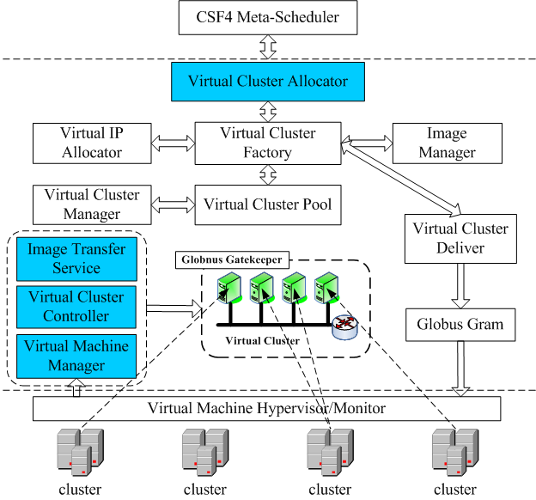
Module design of EVC manager
Interfaces and internal modules
Organize VCs in a pool
VM configuration (IP, image)
VC configuration (subnet, cluster software, …)
Support multiple VMMS (Xen, VMwareServer, etc.)
PRAGMA 19 workshop, Changchun, Jilin, China, Sep.13-15, 2010.
Notes:
This is the module design of EVC manager.
As we can see, there are two type of modules, interfaces that cooperates with users and clusters, which colored blue, and internal modules.
EVC mangers stores the information of vcs in a pool. Detais like VM ip and image configuration, vc subnet and cluster software configuration are addressed by seperated modules.
Current version of EVC manager support multiple VMMs. Both open source and comercial.

Slide 28
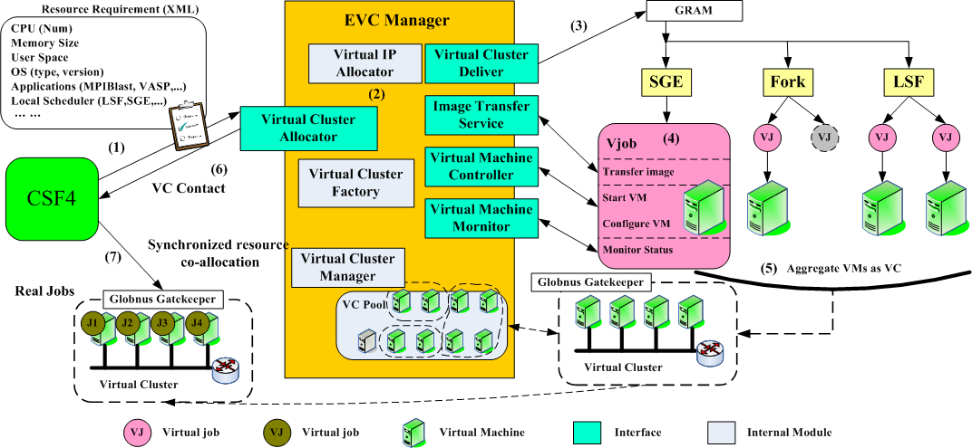
Process of parallel job scheduling
Two-phase scheduling are all based on GSI.
  Resource co-allocation
  Real job distribution
PRAGMA 19 workshop, Changchun, Jilin, China, Sep.13-15, 2010.
Notes:
Let’s see how CSF schedule a parallel job using EVC.
First, CSF parse the resource requirement of a parallel job, such as cpu num, memory size user space …
And send this xml file to EVC manager. Then EVC manager allocate ip for the virtual cluster. Then, virtual cluster deliver send ou vjobs to candidate clusters to reserve resources.
The grey vjob is failed that it did not get resources. The purple ones are successful. Them Vjob start to transfer image from image transfer service and start Vm configure VM. Vjobs are also in charged of monitoring vms during runtime.
After that, Vms are aggregated as vcs and retrieved to EVC manager. EVC manager put it into VC pool.
Virtual cluster allocator successfully return a vc’s gatekeeper contact to CSF4.
Then CSF4 can dispatch real parallel jobs to virtual clusters.

Slide 29
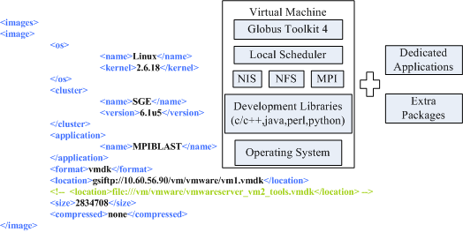
Image management
Image configuration file (XML)
Support image compression to save transmission time
Support dedicated applications by dynamic installation (yum…)
PRAGMA 19 workshop, Changchun, Jilin, China, Sep.13-15, 2010.
Notes:
This slide shows some details about the image management of CSF. A typical image is consists of os, development libs, cluster software nis nfs mpi and local schedulers. The imgages of EVC have globus tookit installed as well to receive real parallel job from CSF using globus protocol.
We support image compression to save transmission time. Then extra packages are supported by dynamic installztion mechanism such as yum of red hat linux.
For example, this is a standard image configuraton in CSF. The image use linux 2.6 kernel, sge cluster, mpiblast application. The image is used by Vmware and 2 gB without compression.

Slide 30

PRAGMA 19 workshop, Changchun, Jilin, China, Sep.13-15, 2010.

Slide 31
Conclusion
CSF4 have been evolved from traditional grid enabled to cloud support.
  Powerful, usable, extendable
New OPAL-CSF model
  Sharing service resources by multiple OPAL sites.
Elastic virtual cluster
  Parallel job co-allocation
  Dynamic executing environment pre-deployment
PRAGMA 19 workshop, Changchun, Jilin, China, Sep.13-15, 2010.

Slide 32
Ongoing works and plans
Virtual cluster live migration strategy
  Concurrent migration protocol
Multi-domain service scheduling policies
  Monitoring service utilization rate
  Scheduling policies
Elastic virtual cluster management strategies
  Reconstruction
  Virtual cluster pool
  Multi-VO users
PRAGMA 19 workshop, Changchun, Jilin, China, Sep.13-15, 2010.

Slide 33


PRAGMA 19 workshop, Changchun, Jilin, China, Sep.13-15, 2010.

